Slide 1
Top Headlines across the World:
News Keywords by Country

Slide 2
Objectives
What are people interested in?
What is happening around the world?
Assumptions:
By treating countries' top headlines as meaningful lists of keywords, we can derive important topics through aggregate analysis of those word lists.
Using natural language keyword extraction algorithms, we can provide meaningful information about world news each day and over time.

Slide 3
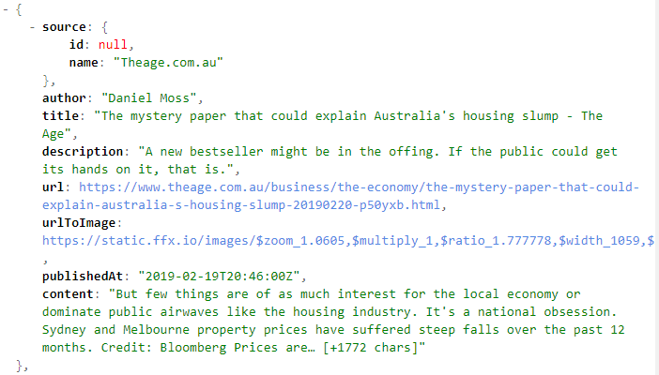
Data Exploration
News API: https://newsapi.org
Headlines and articles from over 30,000 news sources and blogs
Top daily headlines for 138 most notable news sources and 54 countries.

Slide 4
ETL
News API → noSQL database(MongoDB)
  List all available countries
    Save to countries.py for reference to names and codes
  Query News API for top headlines in each country
    Extract source, title, url, and date
    Load to 'countries_data' Collection in MongoDB
  Translate string of all titles for a country with py_translator
    Load to 'countries_words' Collection
  Extract keywords from translated titles string with Rake-NLTK (Natural Language Toolkit)
    Limit keyword phrase length to one or two words
    Score by 'word degree': favors words that occur often and in longer candidate keywords
    Remove 'junk' keywords: keywords with special characters or keywords that are all numbers

Slide 5
App Architecture
Flask RESTful API Routes
/: renders homepage html with map
/geojson: returns geojson boundaries for all countries with data
/map_info: returns country name, top keyword, and center coordinates
/keywords/<country>: returns lists of the top five keywords, all keywords, and all keyword scores
/country/<country>: renders country dashboard html
/charts/<country>:
/blob:
/world:

Slide 6
Live Demo

Slide 7
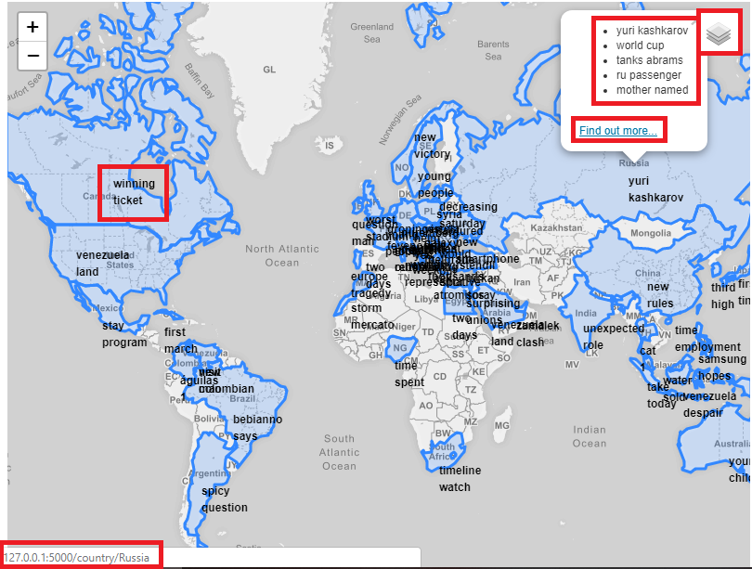
Homepage/Map

Slide 8
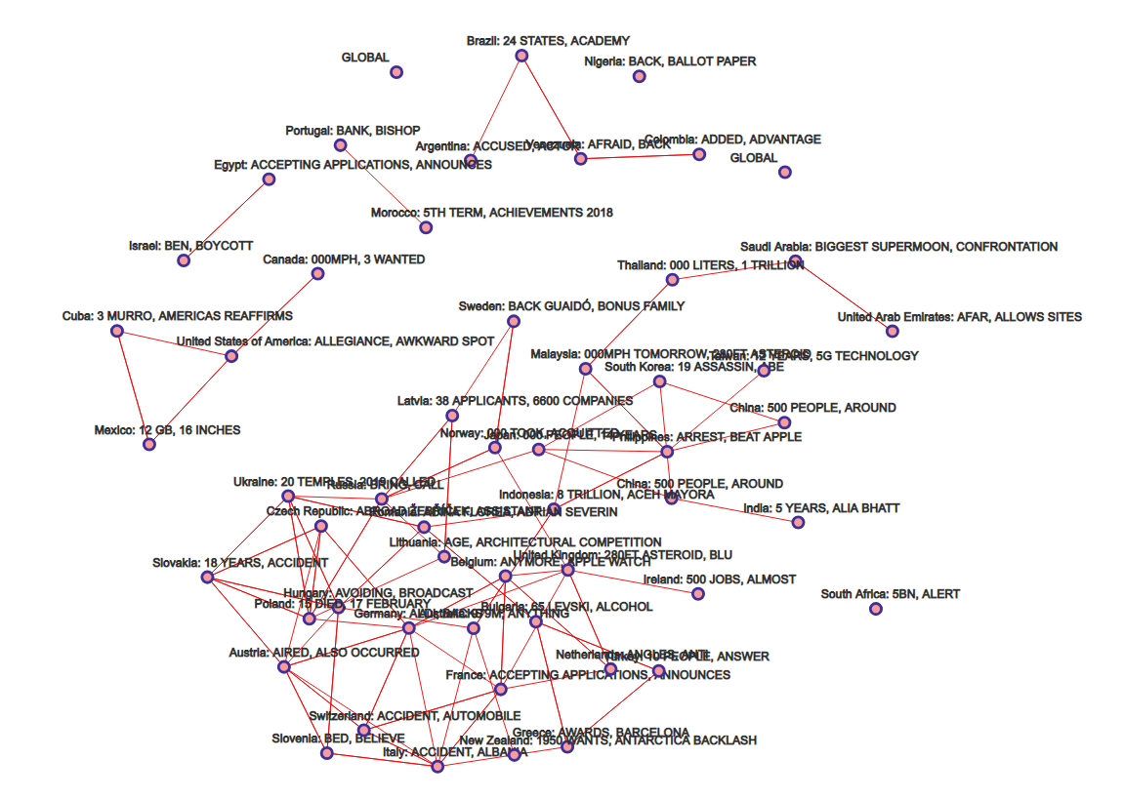
Node Graph

Slide 9
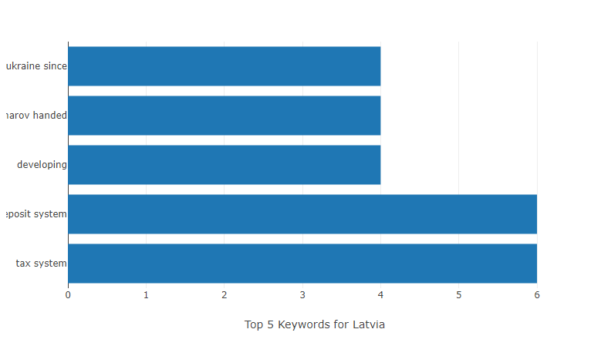
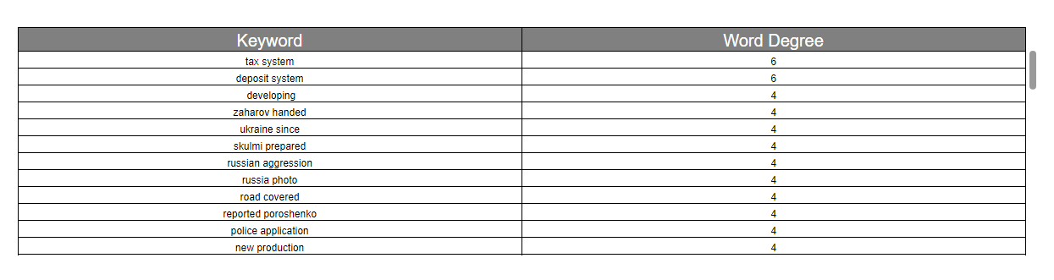
Country Dashboard

Slide 10
Future Development
Heroku Deployment
Deeper analysis of word collections via network analysis
Word Searching
Links to Articles
News Source Analysis: Where do people get their news?

